Slide 1
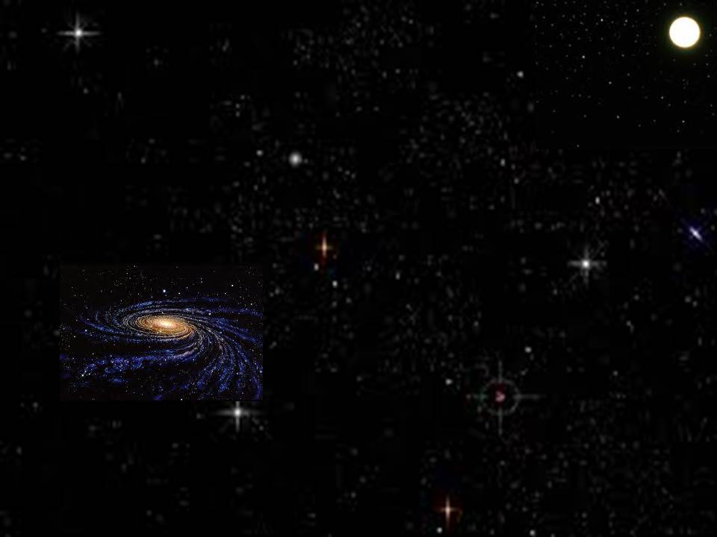
小伯利恒
Little Town of Bethlehem

Slide 2
美哉小城小伯利恆,你是何等清靜
無夢無驚深深睡著,群星悄然進行
在你漆黑的街衢,永遠的光照啟
萬世希望眾生憂驚,今宵集中於你
O little town of Bethlehem, how still we see thee lie!
Above thy deep and dreamless sleep
the silent stars go by;
Yet in thy dark streets shineth the everlasting Light.
The hopes and fears of all the years
are met in thee tonight.

Slide 3
晨星啊,同來頌揚,同來禮拜虔誠
同來感謝至尊上主,同祝世界和平
因馬利亞誕生聖嬰,天上眾軍齊集
世界眾生酣睡正深,天軍虔敬守夜
O morning stars, together proclaim the holy birth,
And praises sing to God the King,
and peace to all on earth!
For Christ is born of Mary, and
gathered all above while mortals sleep,
the angels keep their watch of wondering love.

Slide 4
宏愛上主至大恩典,普賜相信的人
何等莊嚴,何等安靜,肉耳不能聽聞
世界惡貫正滿盈,救主悄然降生
虔誠恭敬打開心門,救主必定降臨
How silently, how silently the wondrous gift is given!
So God imparts to human hearts
the blessings of his heaven.
No ear may hear his coming, but, in this world of sin,
where meek souls will receive him,
still the dear Christ enters in.

Slide 5
哦,伯利恆至聖嬰孩,懇求今再降臨
除我罪孽使我潔淨,安然進入我心
我聞天使在歌唱,宣告大喜信息
求在我心永遠長住,我主以馬內利
我主以馬內利
O holy Child of Bethlehem, descend to us we pray:
cast out our sins and enter in, be born in us today.
We hear the Christmas angels
the great glad tidings tell;
O come to us, abide with us, our Lord Emmanuel.
Our Lord Emmanuel.

